Slide 1

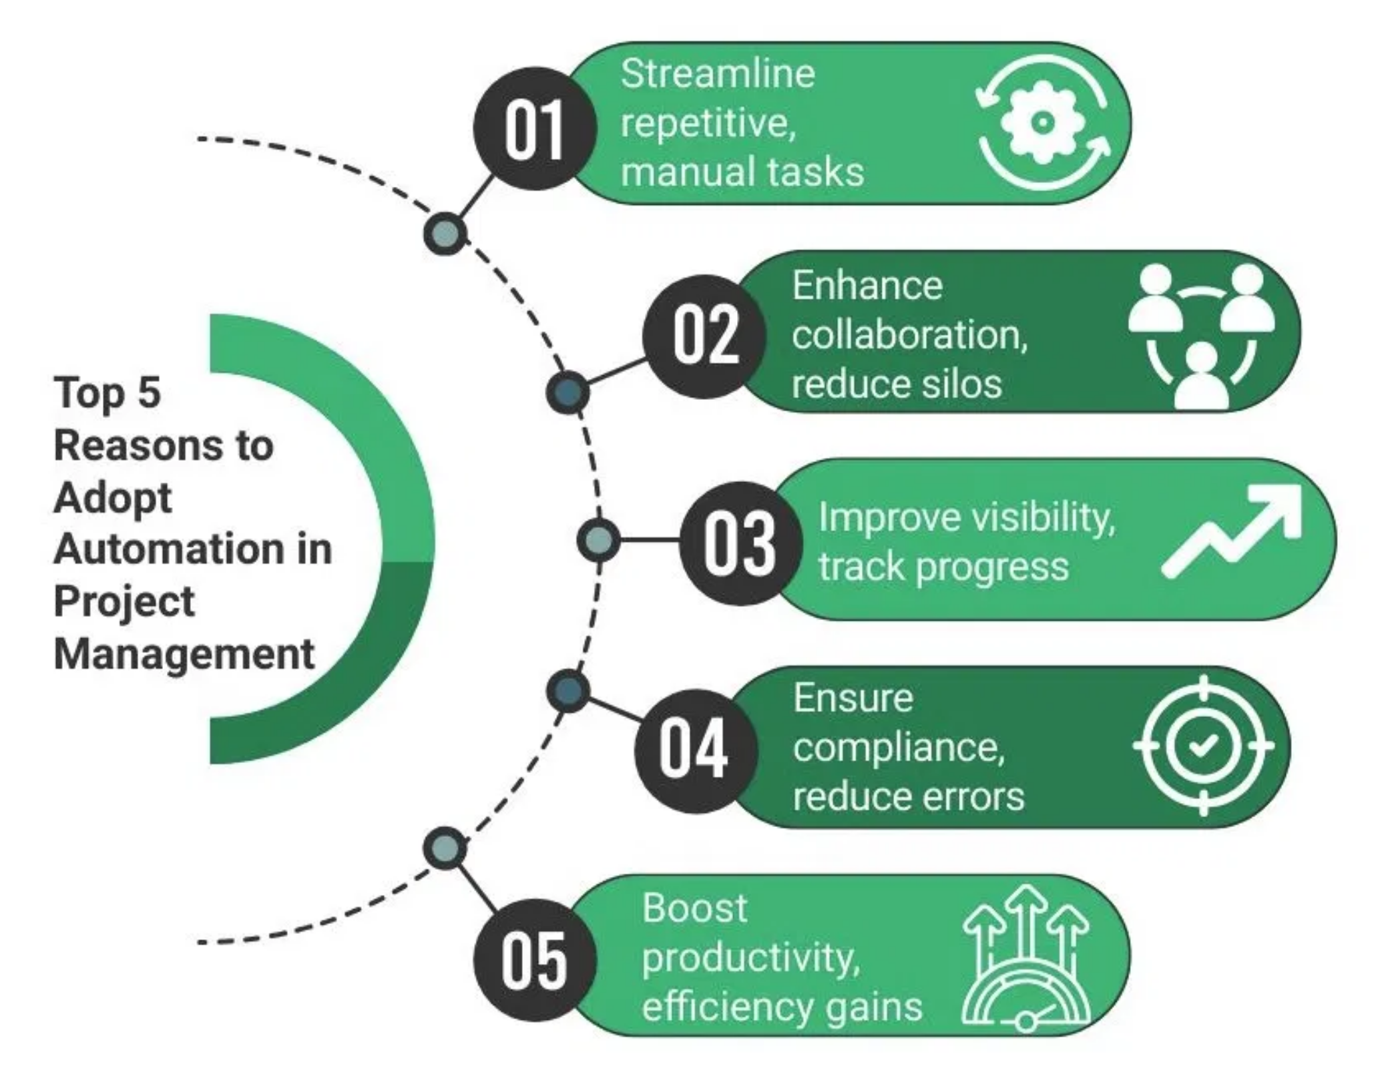
Project Setup Automation Tool
Streamlining Project Management Across Multiple Tools

Slide 2


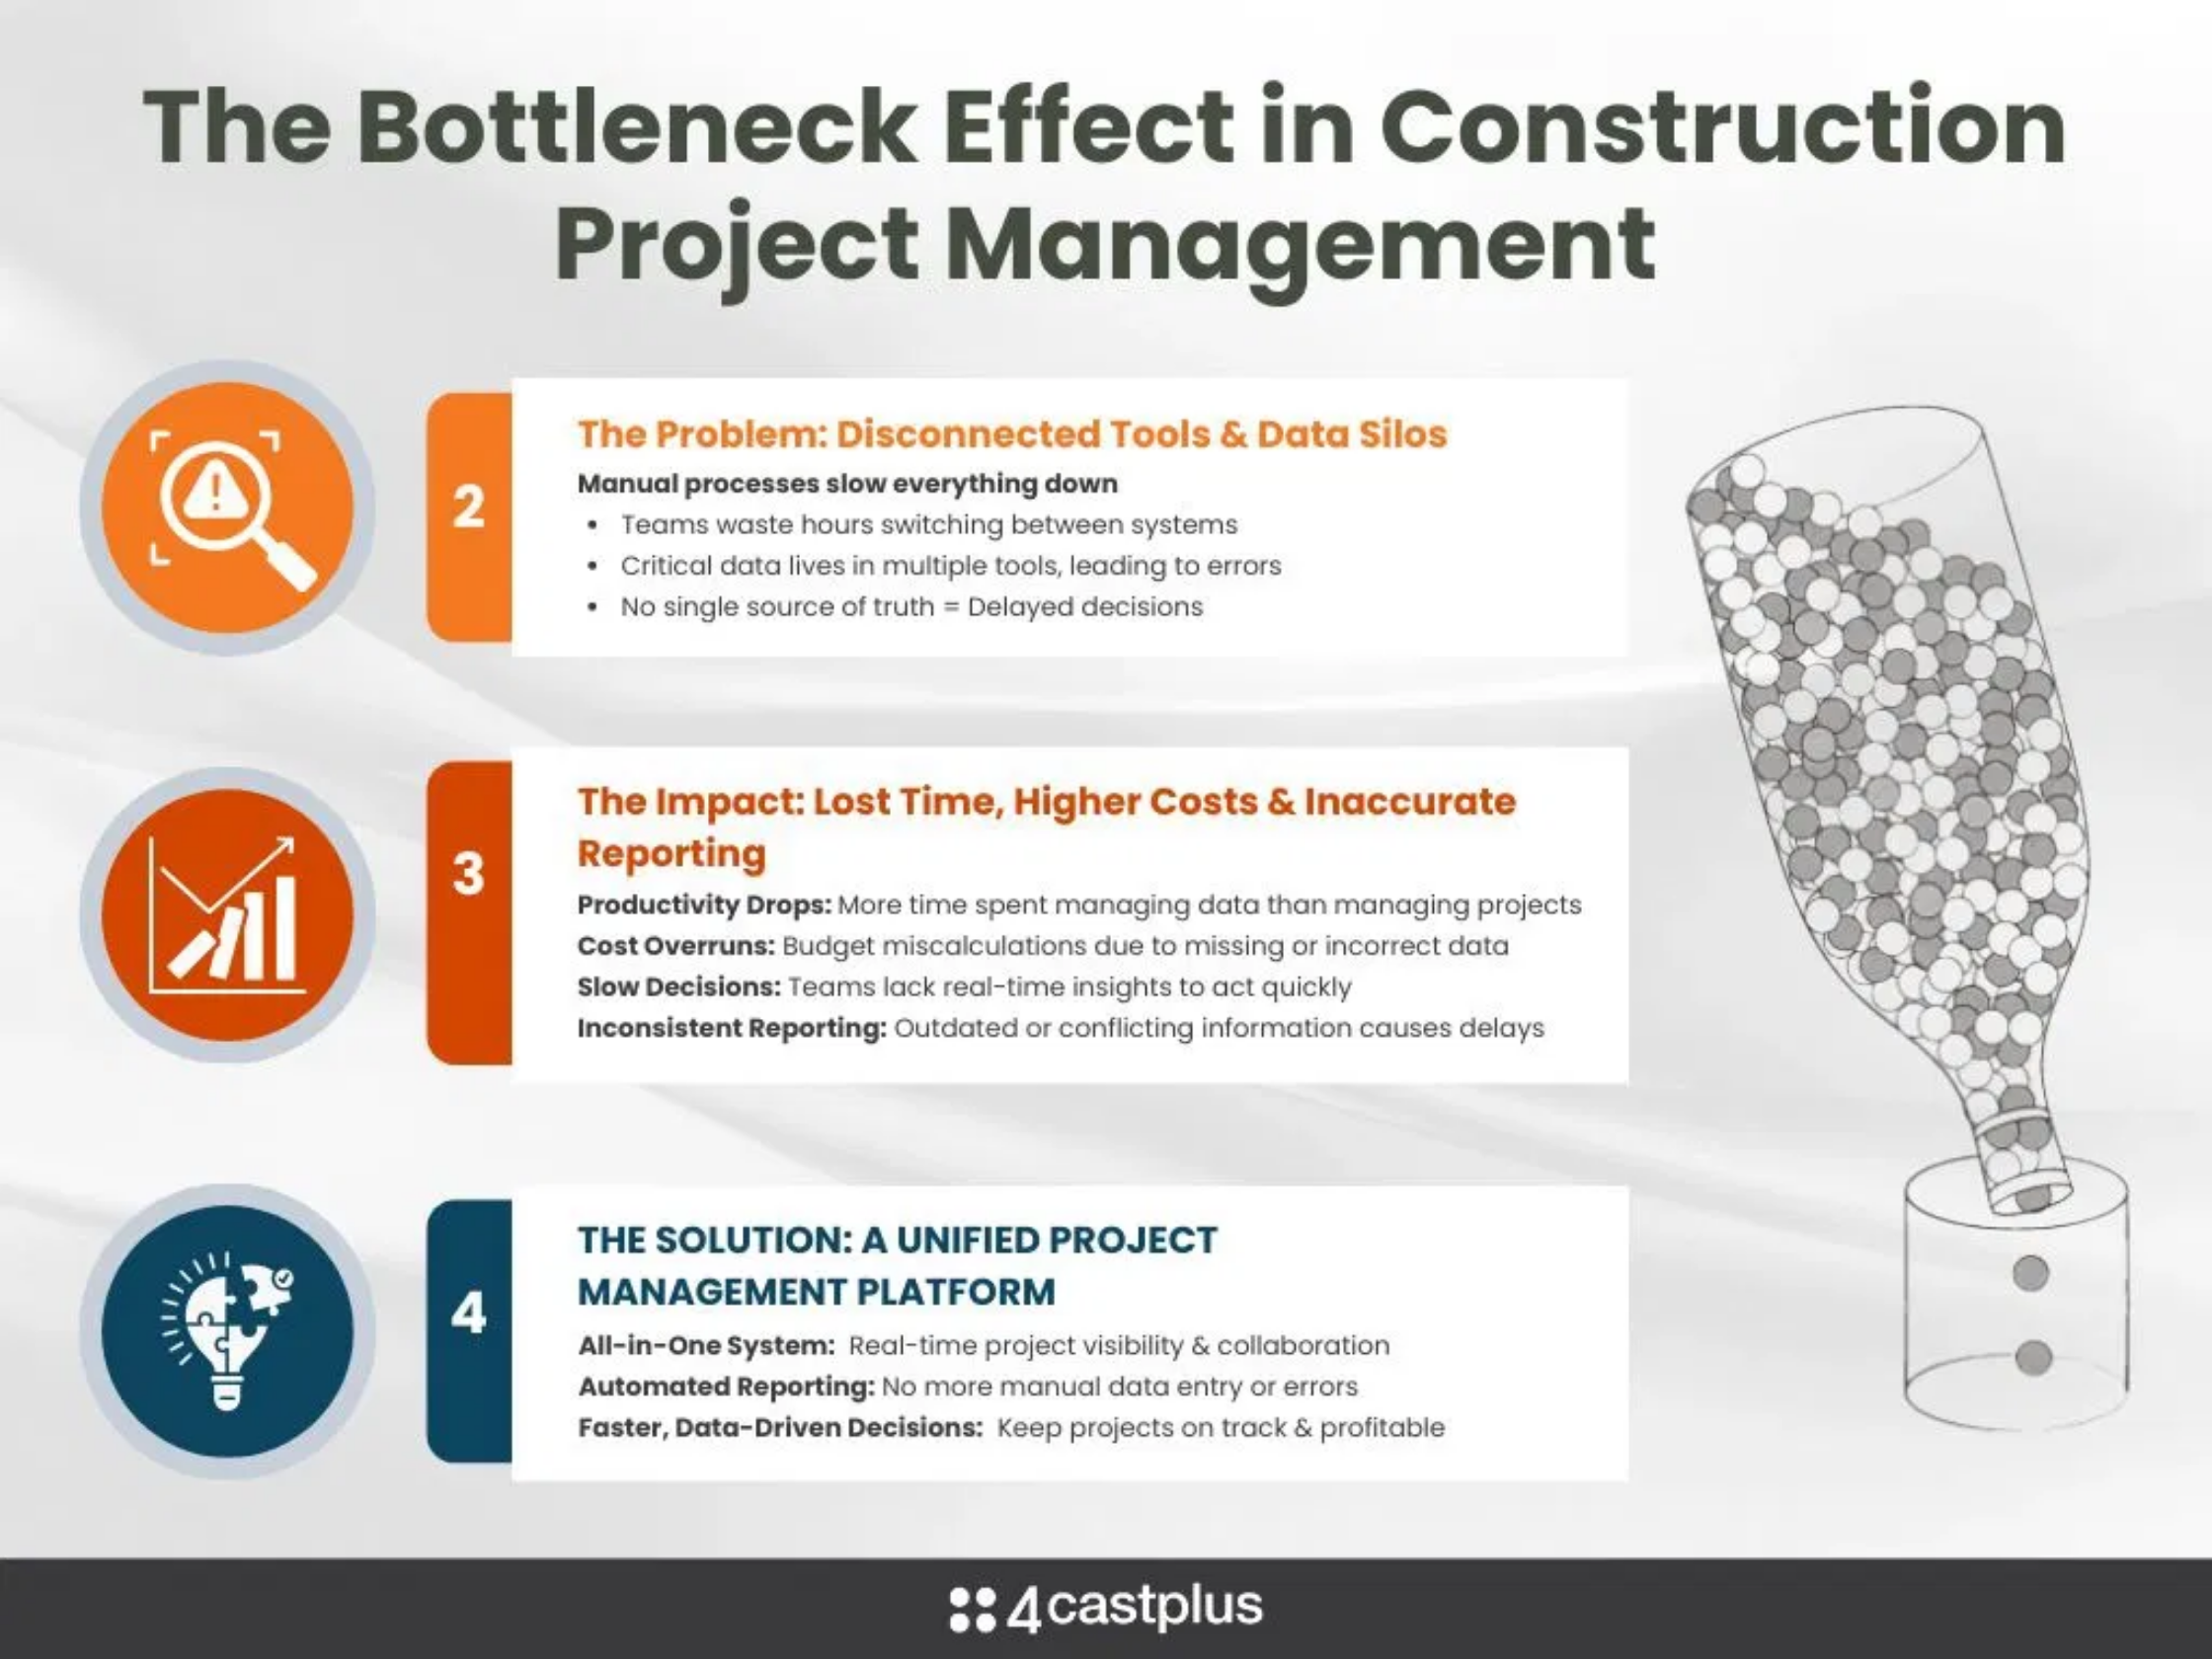



The Problem
Tool Fragmentation:
Project managers must navigate
between Productive, Jira, Confluence, and Outlook,
leading to inefficiency and context switching.
Time-Consuming Setup:
Setting up a new project
across multiple tools can take hours or even days of
manual configuration.
Inconsistency Risk:
Manual setup increases the risk of
inconsistent project configurations and missing critical
steps.
Status Tracking Challenges:
Gathering project status
from multiple tools is labor-intensive and prone to
outdated information.

Slide 3


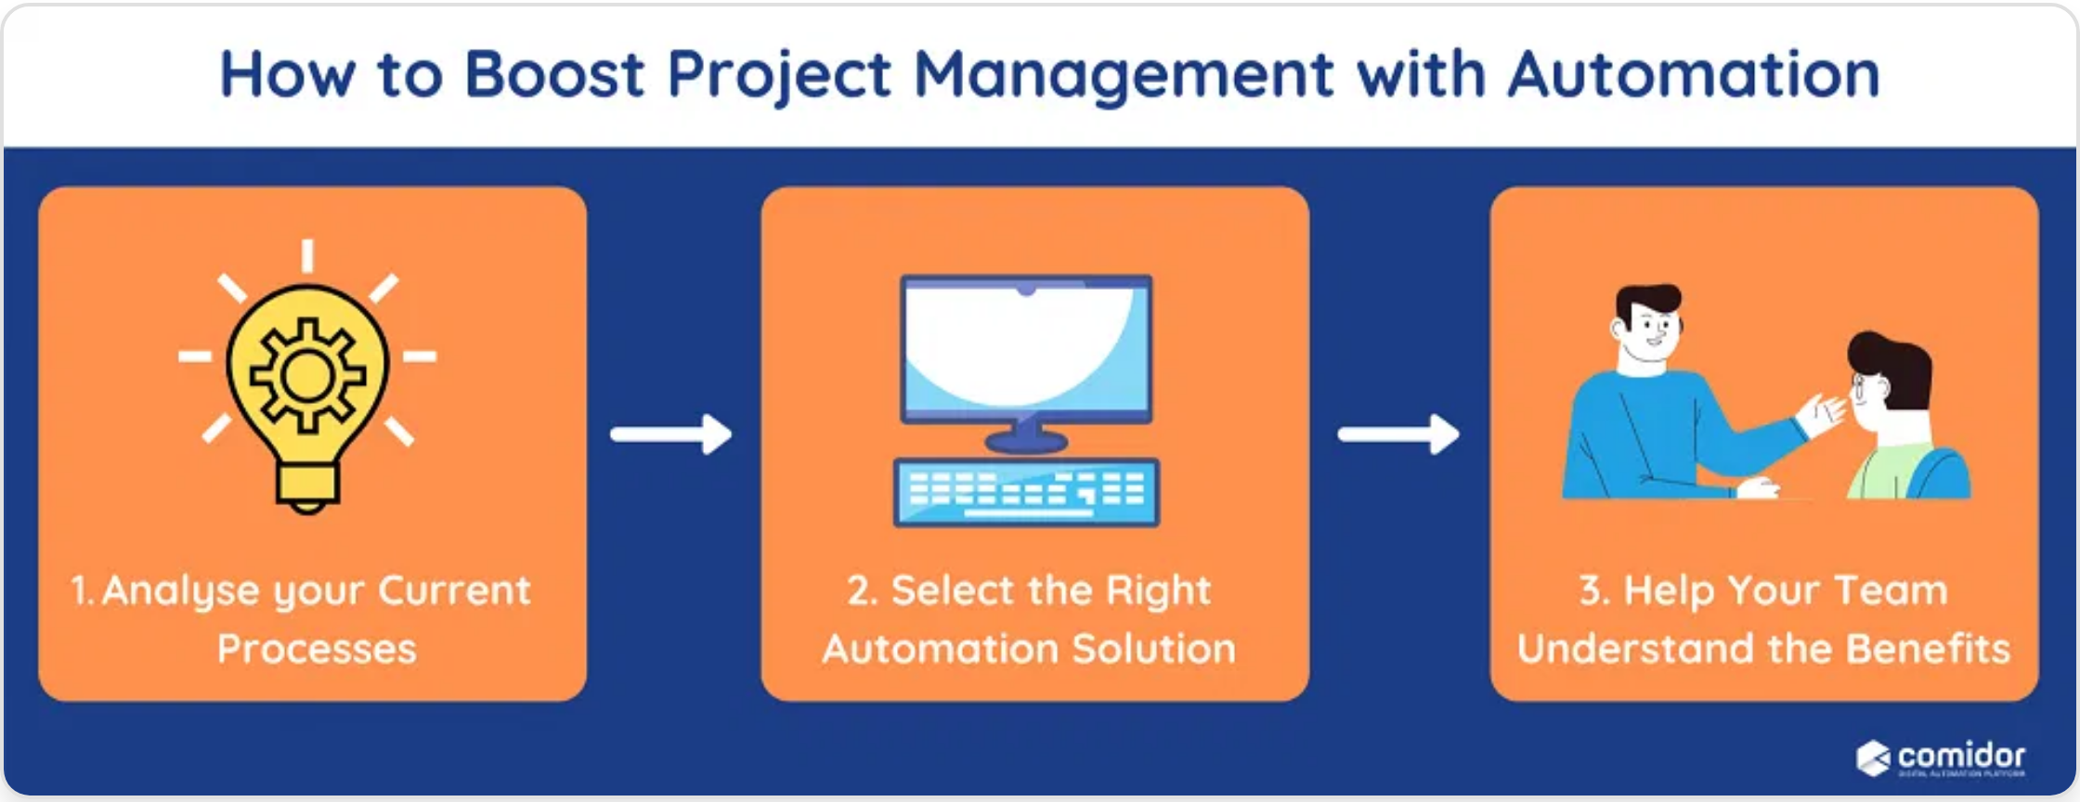



Our Solution
Unified Setup Wizard:
A step-by-step guided process
to configure projects across all tools from a single
interface.
Automated Integration:
Seamless synchronization
between Productive, Jira, Confluence, and Outlook with
minimal manual intervention.
Team Management:
Centralized team member
assignment with role-based permissions across all
integrated tools.
Unified Dashboard:
Real-time project status tracking
and reporting from a single, comprehensive view.
Automated Scheduling:
Intelligent meeting
scheduling with calendar integration and attendee
management.

Slide 4
System Architecture
A multi-tier architecture with secure API integrations to external tools
Frontend
Productive
React.js
Outlook
REST API
Graph API
Jira
Backend
Confluence
REST API
Flask API
REST API
Database
SQLite

Slide 5

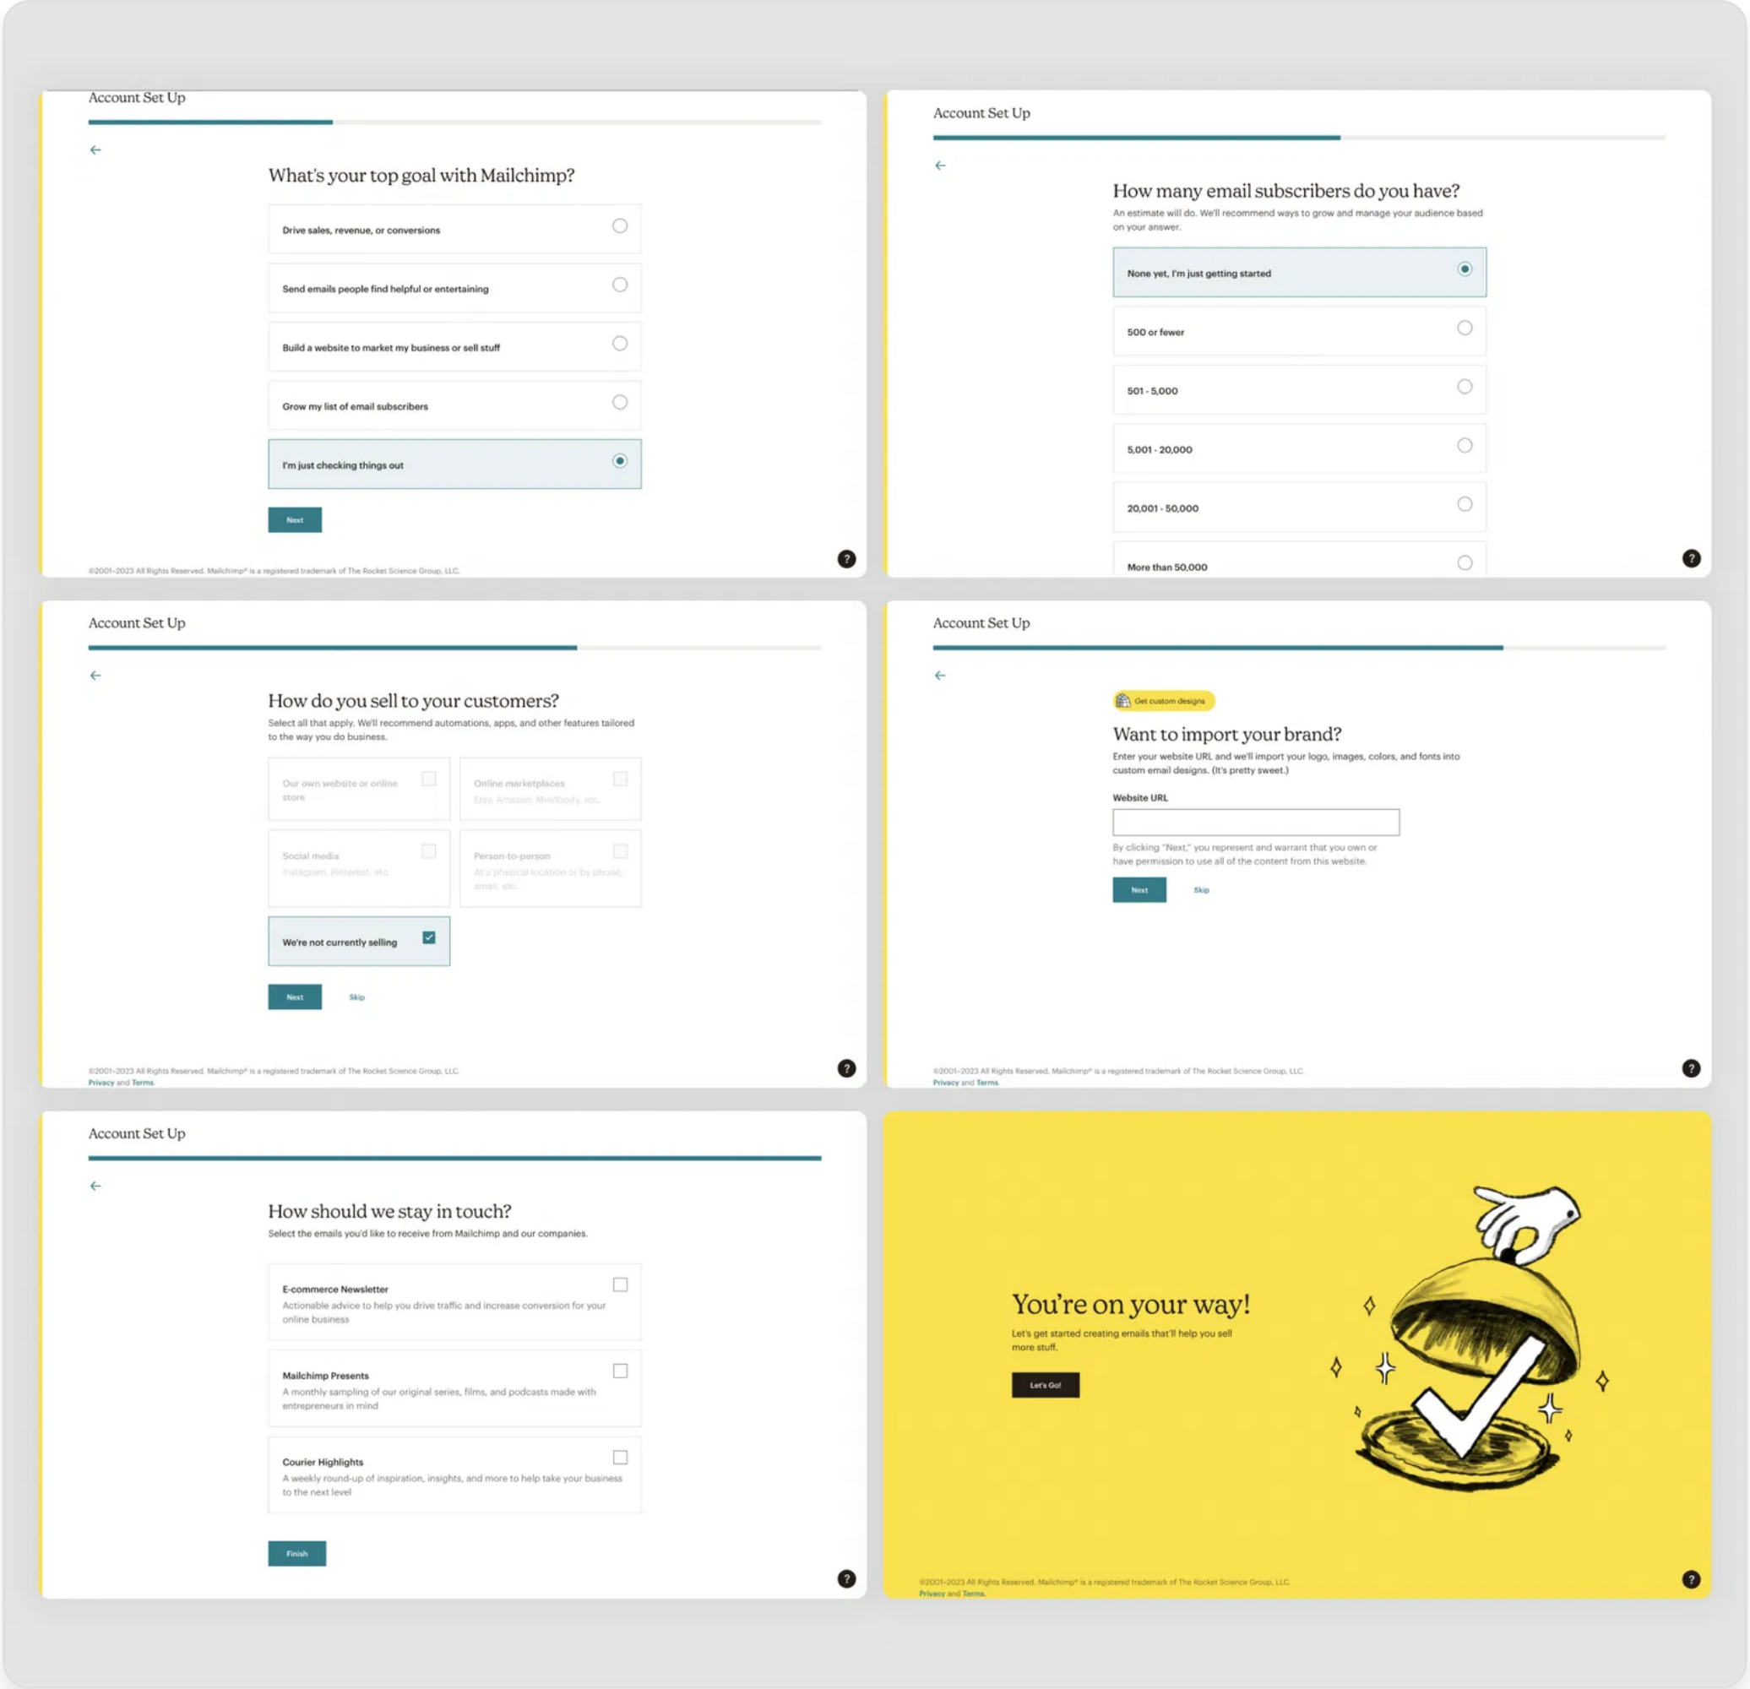
Project Setup Wizard
1
Project Details
Name, key, type, description
Start/end dates, budget
2
Team Members
Add/remove team members
Assign roles across all tools
3
Meeting Schedule
Steering meetings (bi-weekly/weekly)
PM alignment sessions
4
Tool Configuration
Jira, Confluence, Productive setup
API credentials and preferences
5
Review & Submit
Verify all settings
Trigger automated setup process

Slide 6

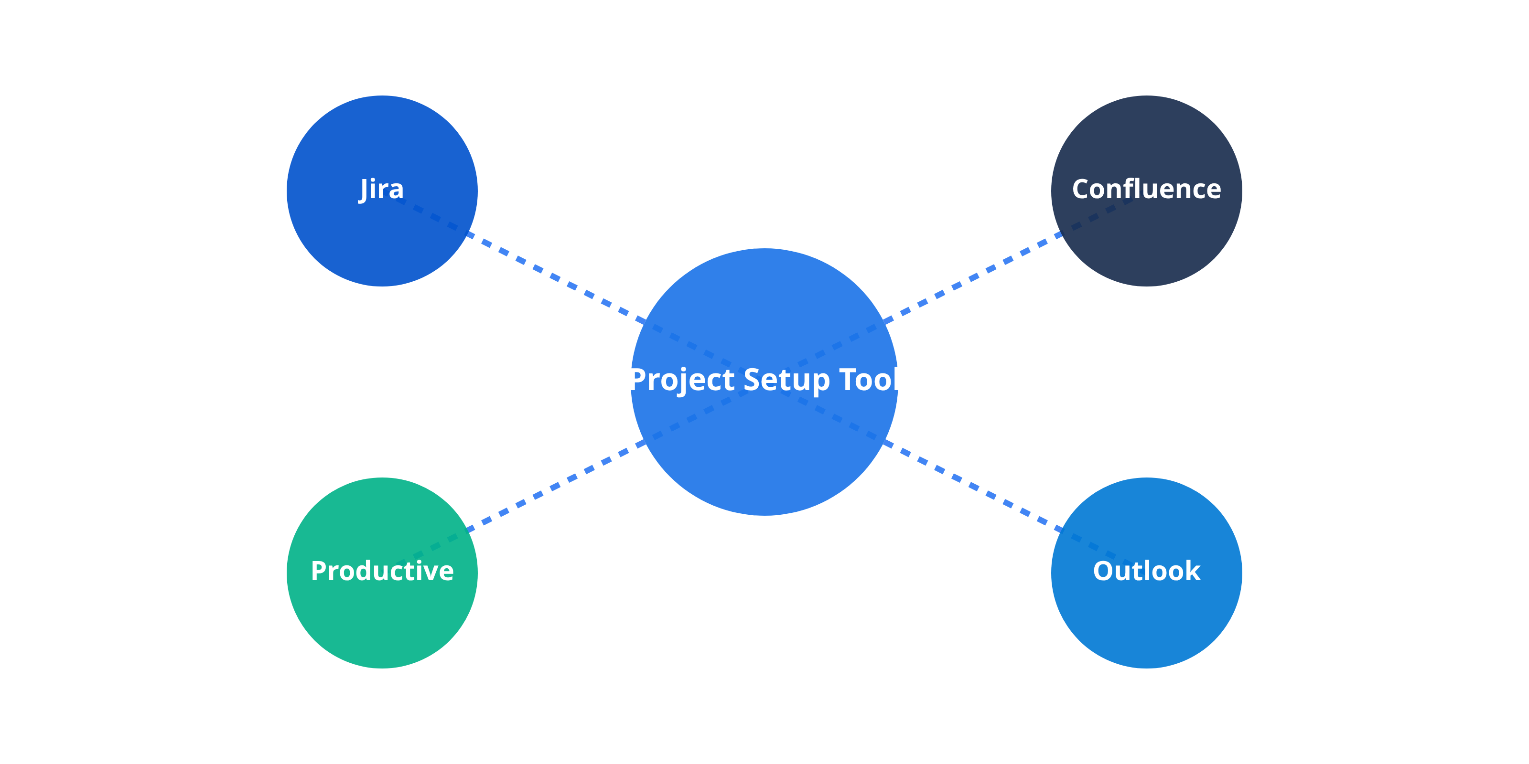




Tool Integrations
Jira Integration
Confluence Integration
Productive Integration
Outlook Integration
Automatically creates projects, configures workflows, and assigns team members. Synchronizes task status and progress for real-time reporting.
Schedules recurring meetings, sends calendar invites, and manages attendee lists. Synchronizes project milestones with team calendars.
Creates project spaces with predefined templates. Establishes links between documentation and Jira tickets for seamless traceability.
Allocates resources, sets up budget tracking, and manages team assignments. Provides real-time financial insights and resource utilization.

Slide 7
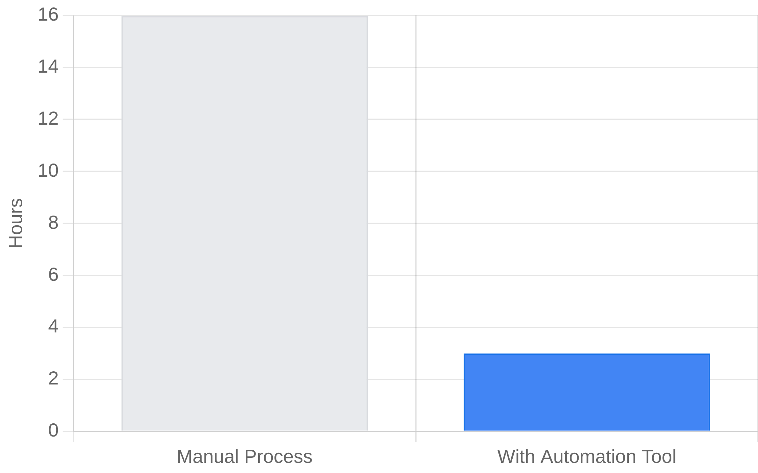



Benefits & ROI
Time Savings:
Reduce project setup time by up to 80%,
Time Saved per Project Setup
from days to minutes.
Consistency:
Ensure standardized project setup across
all tools and teams.
Improved Visibility:
Gain real-time insights into
project status and resource allocation.
Enhanced Collaboration:
Streamline communication
and coordination across teams.
Cost Reduction:
Lower administrative overhead and
reduce tool management costs.

Slide 8

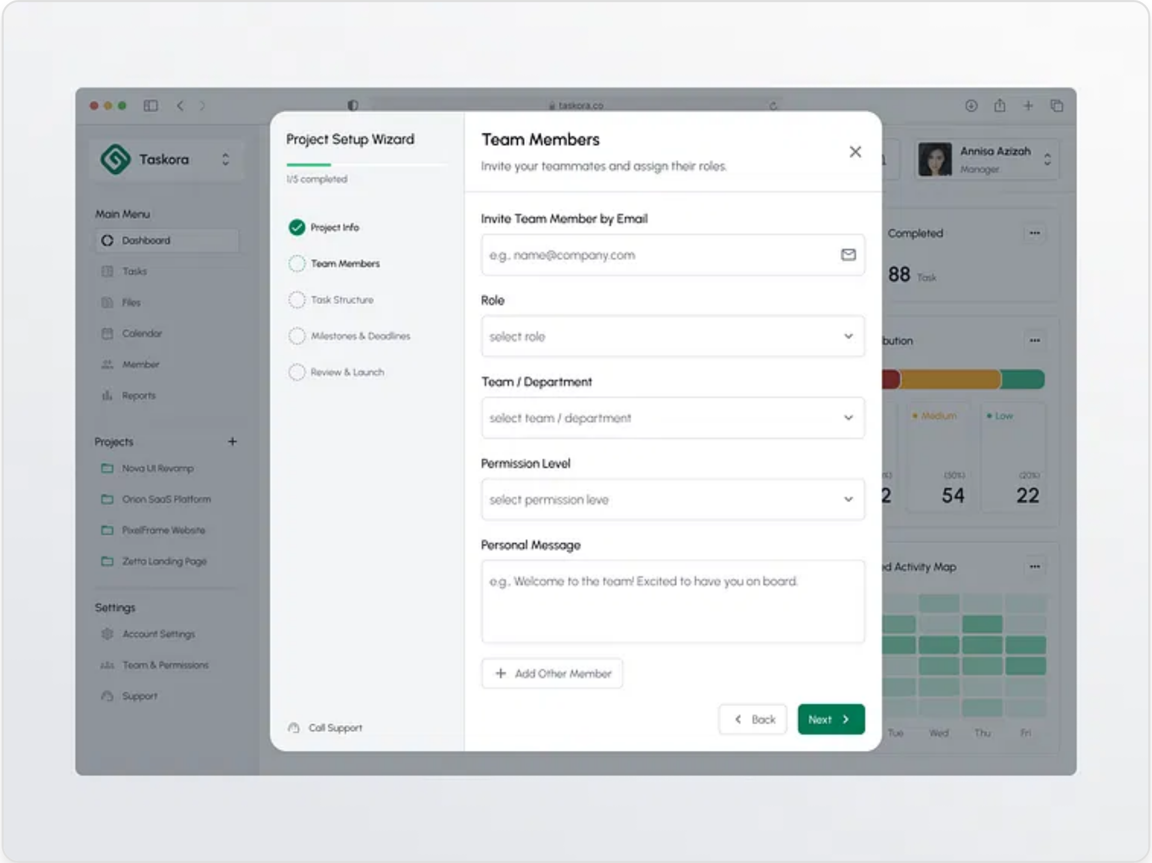





Live Demo
Try It Yourself:
Experience the full project setup
wizard with our interactive demo.
Demo Credentials:
Use username:
demo@example.com
and password:
demo123
to
access all features.
Sandbox Environment:
Create test projects without
affecting production systems.
Guided Tour Available:
Request a personalized
walkthrough with our team for a deeper dive.
Scan to access demo
demo.projectsetup.example.com

Slide 9




Next Steps
Pilot Program
Join our pilot program to test the tool with your team and provide feedback for refinement.
2025 Q4
Q4
Custom Integration
Beta release with core features and initial integrations
We can customize the tool to integrate with your specific workflow and additional tools.
2026 Q1
Q1
Full release with complete tool integrations and enhanced reporting
Training & Onboarding
Comprehensive training sessions for your team to ensure smooth adoption.
2026 Q2
Q2
Advanced analytics and AI-powered recommendations
Full Deployment
Roll out the solution across your organization with our implementation support.
2026 Q3
Q3
Enterprise features and additional third-party integrations
Contact us: projectsetup@example.com

